Slide 1
Section 2.2
Graphs of Equations In Two Variables;
Intercepts; Symmetry

Slide 3

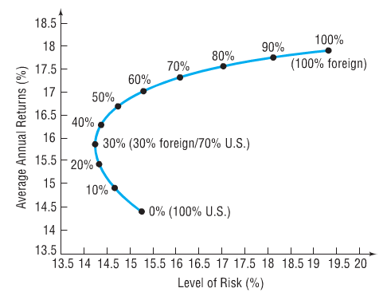

Slide 4

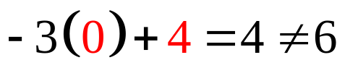
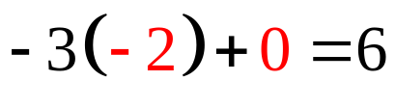
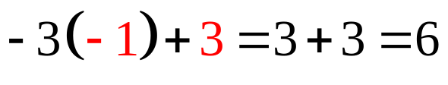
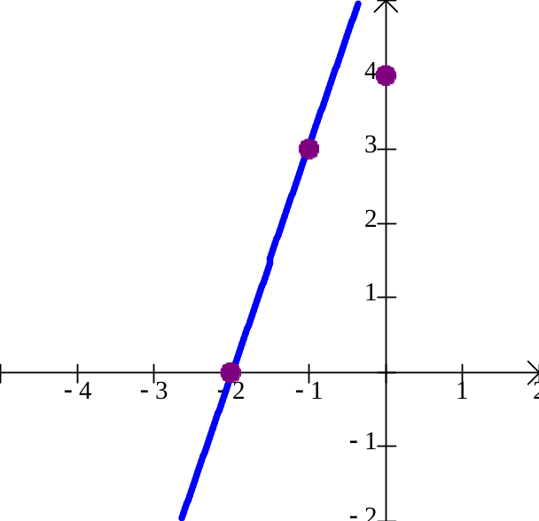
Determine if the following points are on the graph of the equation – 3x + y = 6
(a) (0, 4)
(b) (–2, 0)
(c) (–1, 3)

Slide 5

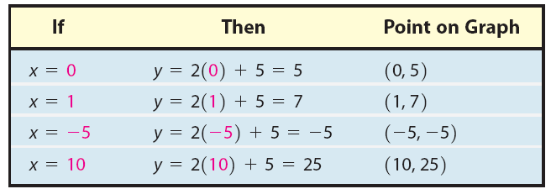
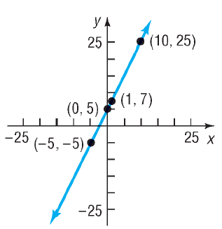

Slide 6

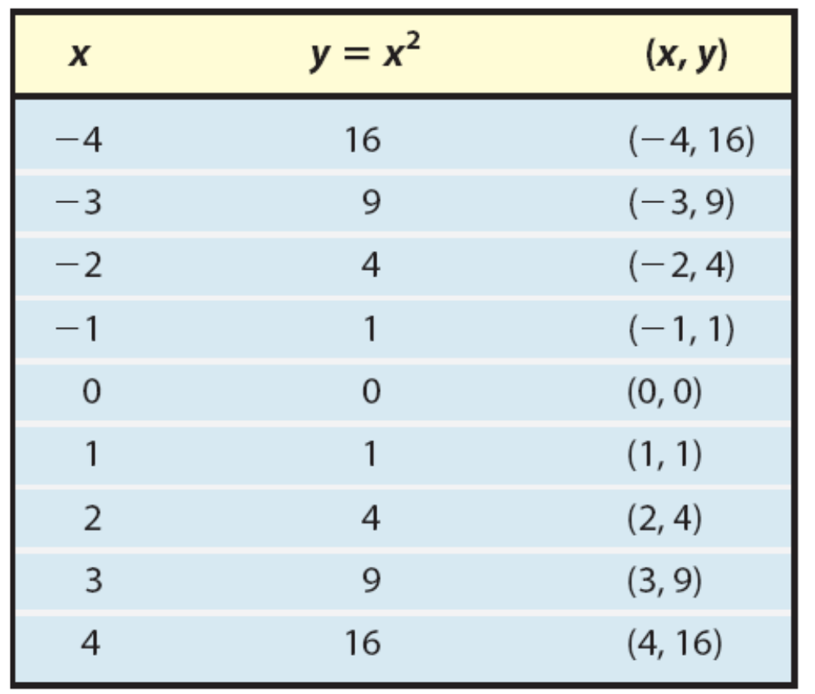
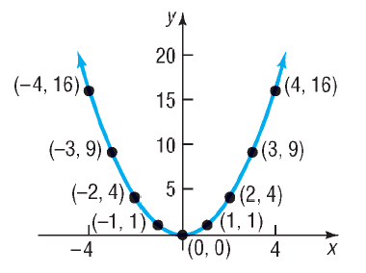

Slide 7


Slide 8
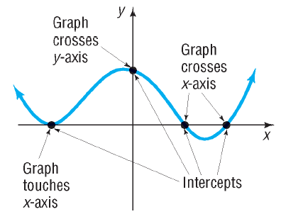

Slide 9

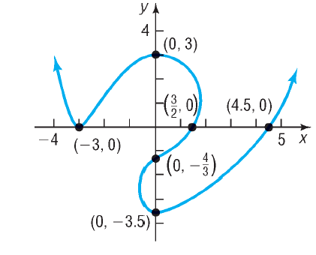
.

Slide 10


Slide 11
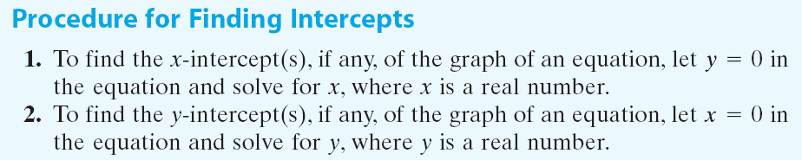

Slide 12
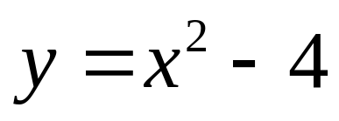
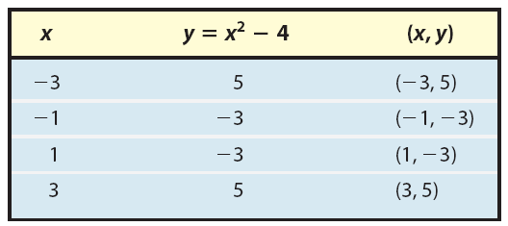
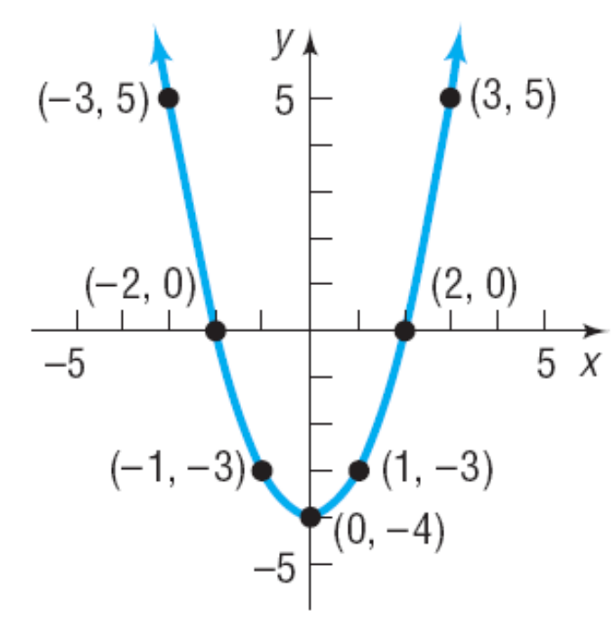
Find the x-intercept(s) and the y-intercept(s) of the graph of then graph by plotting points.

Slide 13


Slide 14

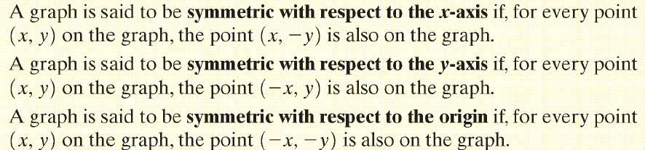
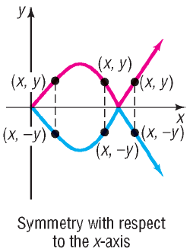

Slide 15
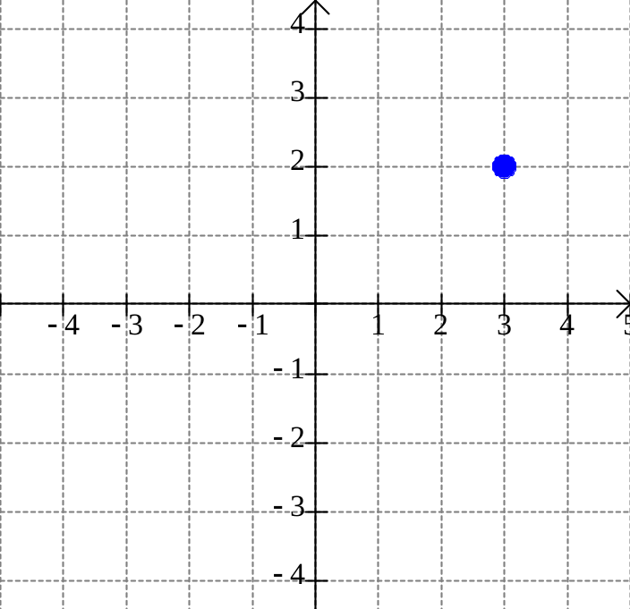
If a graph is symmetric with respect to the x-axis and the point (3,2) is on the graph, what other point is also on the graph?
(3,2)
(3,–2)

Slide 16
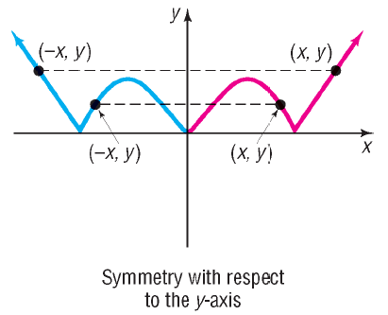

Slide 17
If a graph is symmetric with respect to the y-axis and the point (3,2) is on the graph, what other point is also on the graph?
(–3, 2)
(3,2)

Slide 18
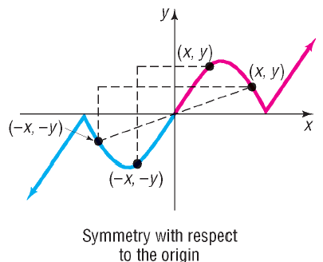

Slide 19
If a graph is symmetric with respect to the origin and the point (3,2) is on the graph, what other point is also on the graph?
(3,2)
(–3, –2)

Slide 21
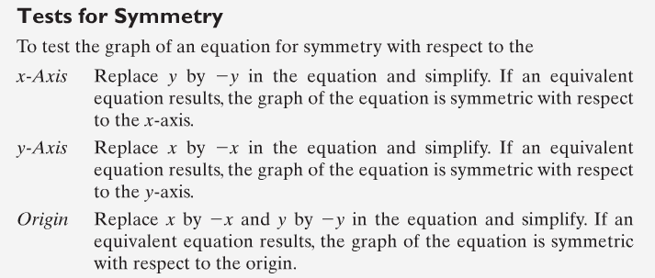

Slide 22
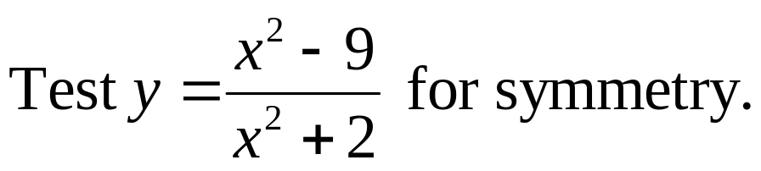
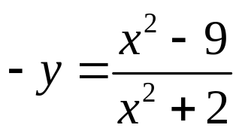
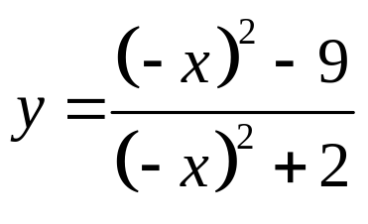
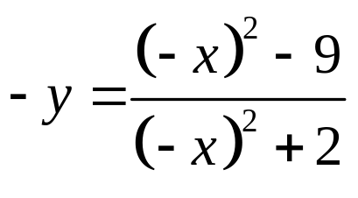


x-Axis:
Not equivalent so not symmetric with respect to the x-axis.
y-Axis:
IS equivalent so symmetric with respect to the y-axis.
Origin:
Not equivalent so not symmetric with respect to the origin.

Slide 23


Slide 24


Slide 25
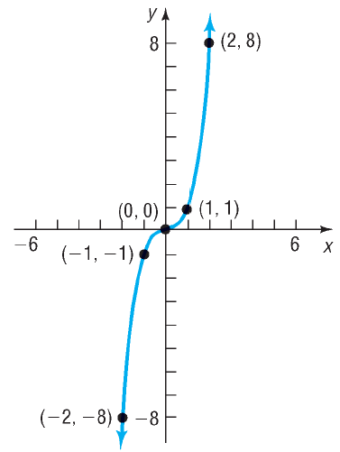
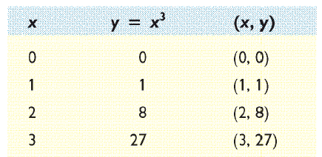

Slide 26


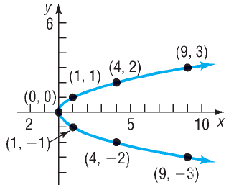

Slide 27


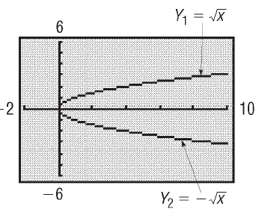
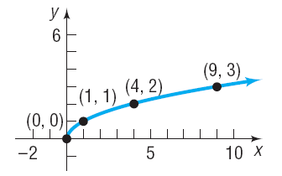

Slide 28


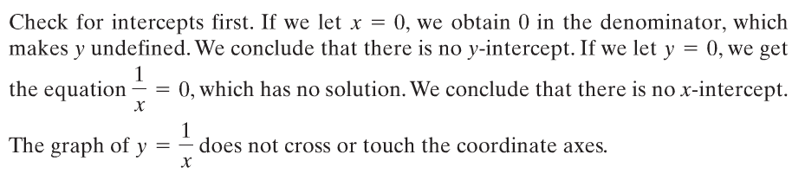
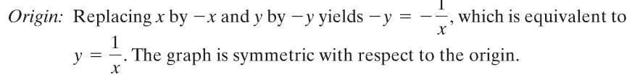

Slide 29
